Slide 1
Restaurant Delivery and Pickup System
By: Abdullah Ghurab
Gandeev Niraula
Sapana Poudel

Slide 2
ABOUT PROJECT
Title of the Project: Restaurant Food Delivery and Pickup System
Technology: . Net Framework (ASP.Net, Web Development Tools)
Front End Development: HTML, CSS, JavaScript, C#
Database: SQL Server Data Tool in Visual Studio 2017
Project Started: 09/13/2018
Anticipated Completion: 05/04/2019
Web Application, Server, and Database

Slide 3
Role of Team Members
Requirements Collection & Web Page Design: Sapana Poudel
System Architecture and Web Page Design: Gandeev Niraula
Database Design and MySQL: Abdullah Ghurab

Slide 4
What is Restaurant Food Delivery and Pickup System (RFDPS)
This is a web application for Individual restaurant.
Allows user to order and get their food deliver to their door.
Allows customer to pay online or pay at the store
Provides faster and convenient service to the customer

Slide 5
Progress up to date:
Requirements Collection (Functional and Non-Functional)
System Architecture
Use Case Diagram
Home Page
Signup Page
Login Page

Slide 6
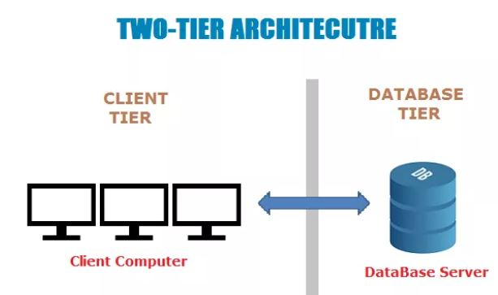
System Architecture
Two tier Architecture
Client-Server Architecture
Client System handles both application and presentation layer.
Server system- Database Layer
Client- Server Communication

Slide 7
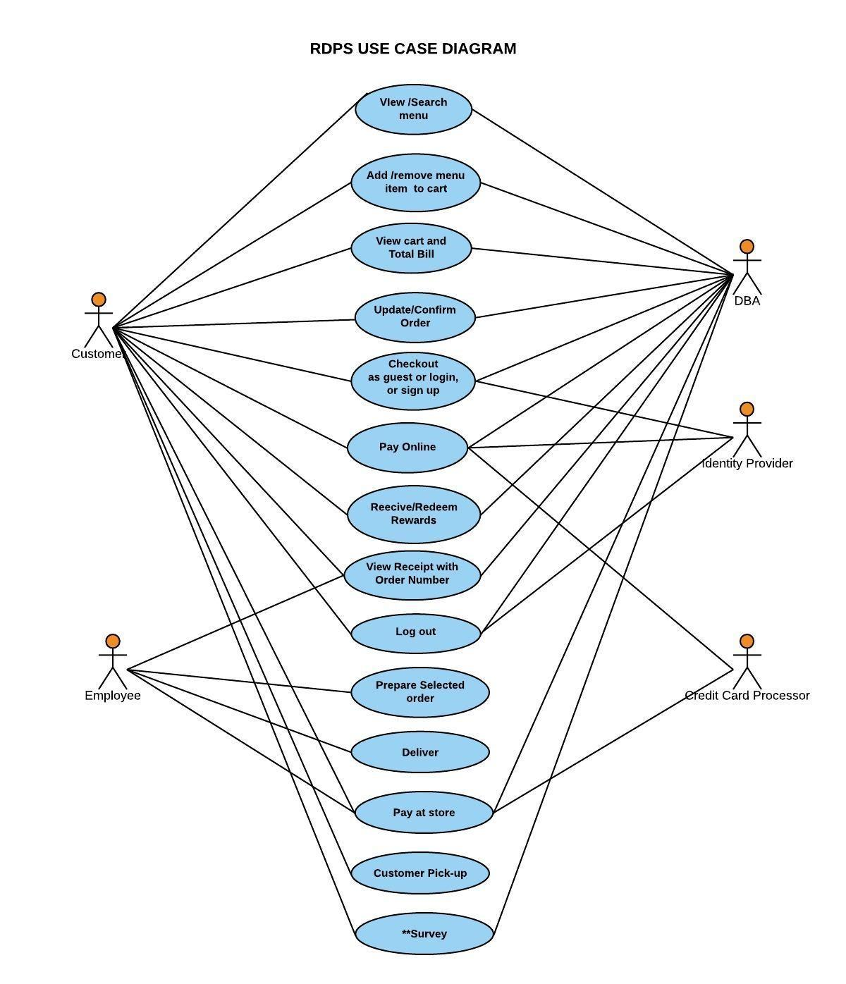
Use Case Diagram (System)

Slide 8
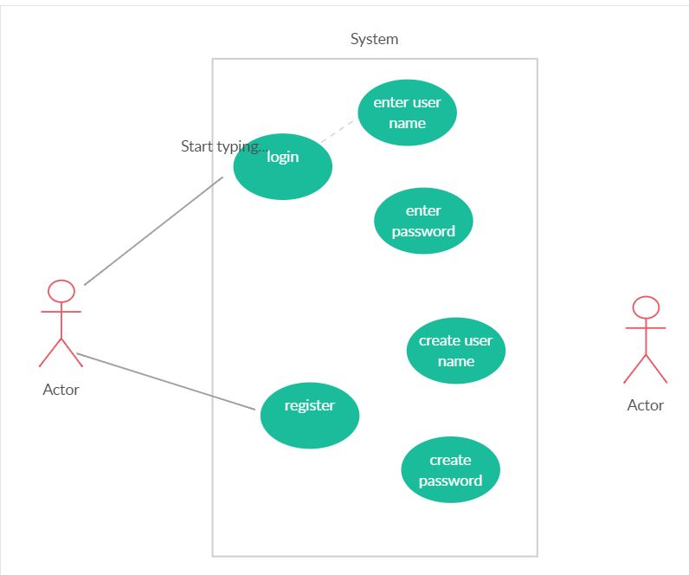
Use Case Diagram (Register and Login)

Slide 9
Table
CREATE TABLE [dbo].[Table] (
[Id] INT NOT NULL,
[UserName] NCHAR (20) NULL,
[Email] NCHAR (50) NULL,
[Password] NCHAR (20) NULL
);

Slide 10
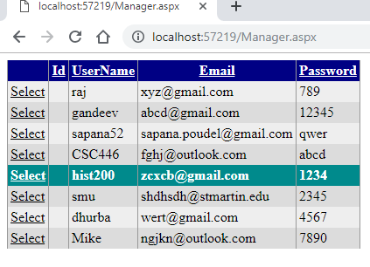
User Data

Slide 11
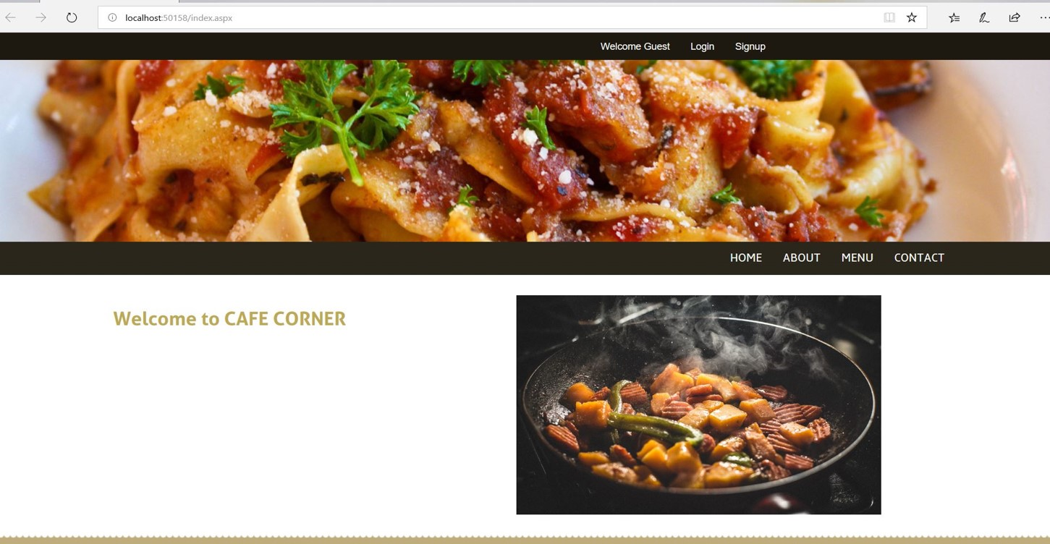
Home Page

Slide 12
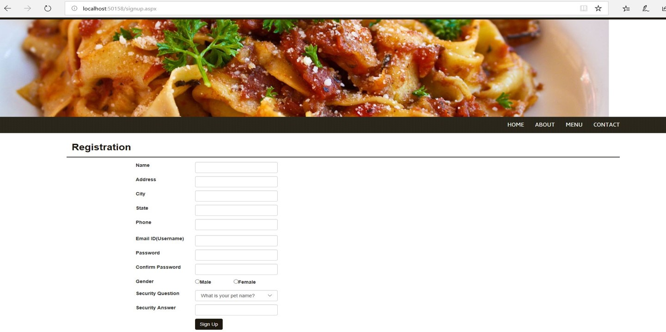
Signup Page

Slide 13
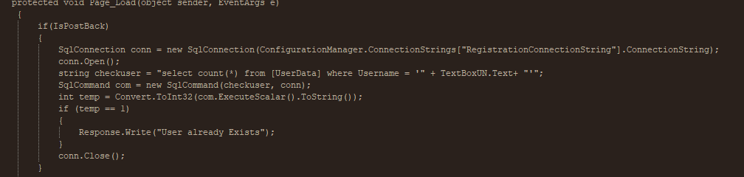
Connecting Sign Up to the Database

Slide 14
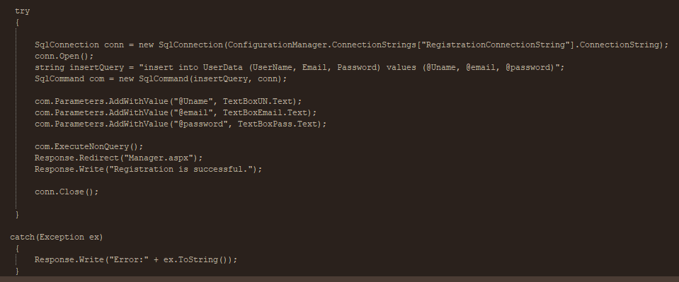
Code…………..

Slide 15
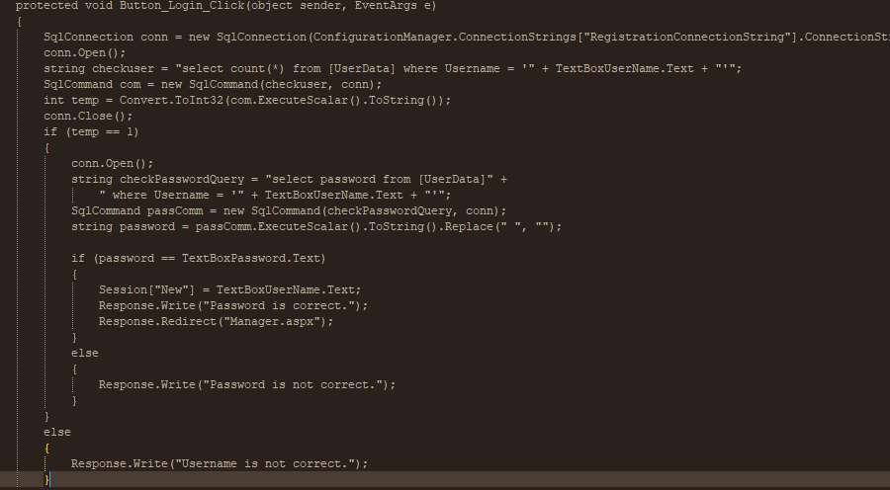
Login Page

Slide 16
Remaining Work
Adding search box to the homepage
Menu page
Add/Remove Items to and from the cart.
Checkout Page
Order Summary Page
Contact Us Form.
Testing
Deploy

